Slide 1
AWS Application Deployment
Applied AI with Azure
Razin Bin Zaidun

Slide 2
Agenda
Introduction to Azure Speech to Text, Language Service & Function App
How Azure STT, Language Service & Function App works
Why use Azure STT, Language Services & Function App
Cost Optimization
Summary & Recommendation

Slide 3
Introduction

Slide 4

What are the services?
Azure Speech to Text
Azure Speech to Text accurately transcribes spoken language for voice-driven and transcription applications.
Language Service: Summarizer
Language Service enables sentiment analysis, entity recognition, and language understanding using NLP.
Serverless Compute Integration: Function App
Azure Function App provides serverless compute for running code without managing infrastructure, ideal for automation.

Slide 5
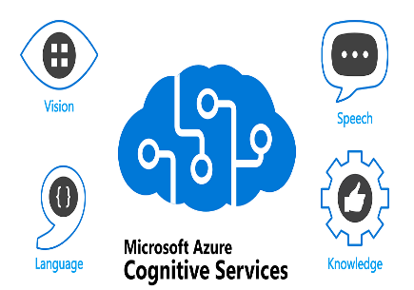
How it works
Audio Input Processing
Audio input is captured from users or devices and converted into text using advanced speech-to-text technology.
Language Analysis Service
Textual data is analyzed to extract insights like intent, sentiment, and key phrases for deeper understanding.
Workflow Orchestration
Azure Function App manages the workflow, triggering actions based on analyzed data for real-time and scalable processing.

Slide 6

Why Use Azure Services
High Accuracy and Multilingual Support
Azure STT and Language Services deliver high accuracy and support multiple languages for diverse global applications.
Seamless Azure Integration
These services integrate smoothly with the Azure ecosystem, allowing easy development of end-to-end solutions.
Serverless Flexibility with Function App
Function App provides serverless execution, reducing overhead and enhancing cost efficiency for developers.
Enhanced Productivity and Scalability
Together, these benefits improve productivity, scalability, and user experience for modern enterprises.

Slide 7

Cost Optimization
Optimized Pricing Tiers
Selecting suitable pricing tiers for speech and language services based on usage reduces unnecessary expenses.
Serverless Execution
Using Function App for serverless execution minimizes infrastructure costs by charging only for compute time used.
Auto-Scaling Resources
Auto-scaling ensures efficient resource allocation, preventing over-provisioning and reducing costs.

Slide 8
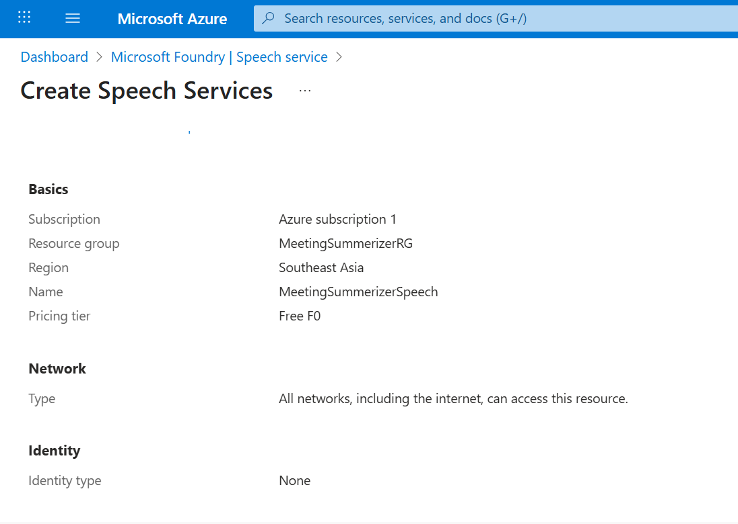

Slide 9
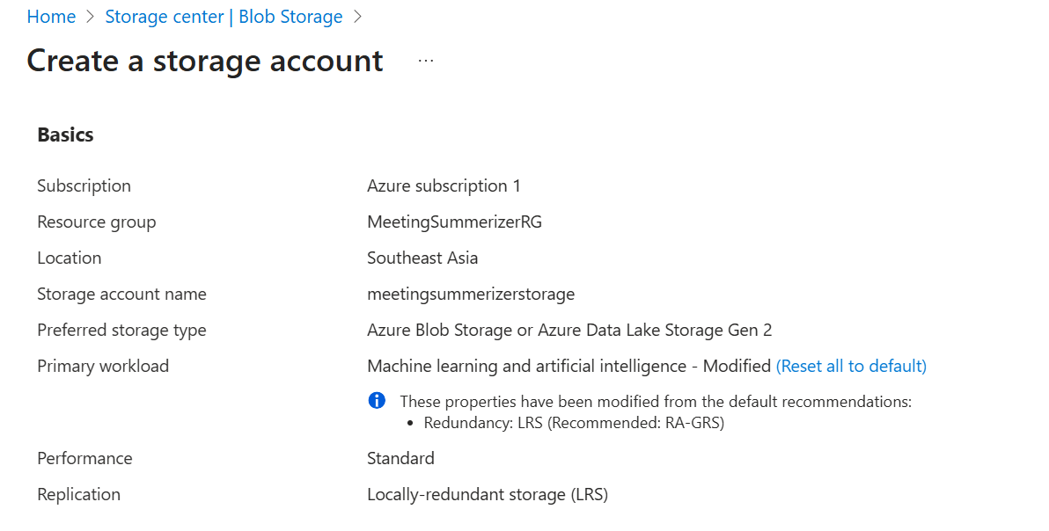

Slide 10
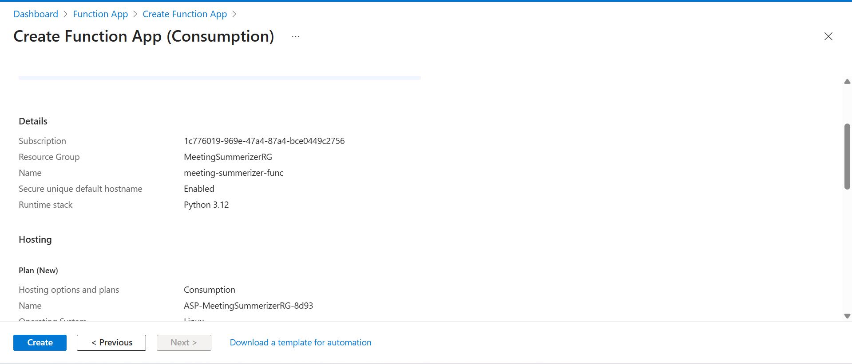

Slide 11
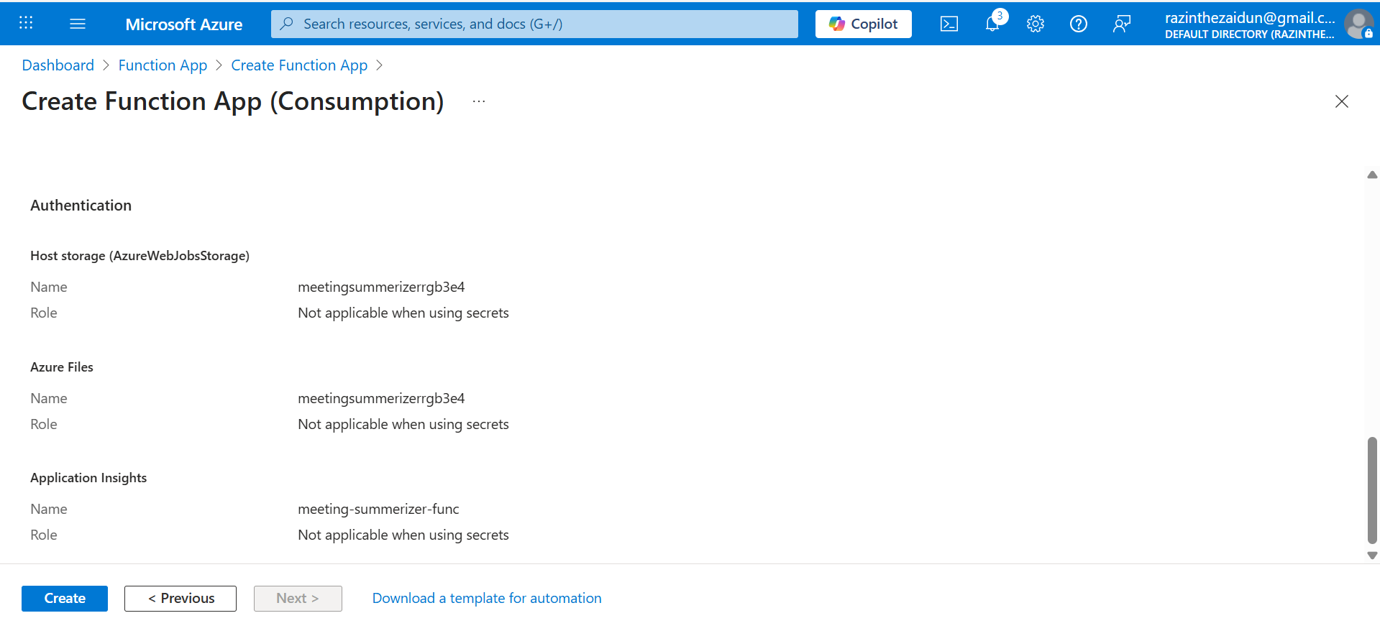

Slide 12
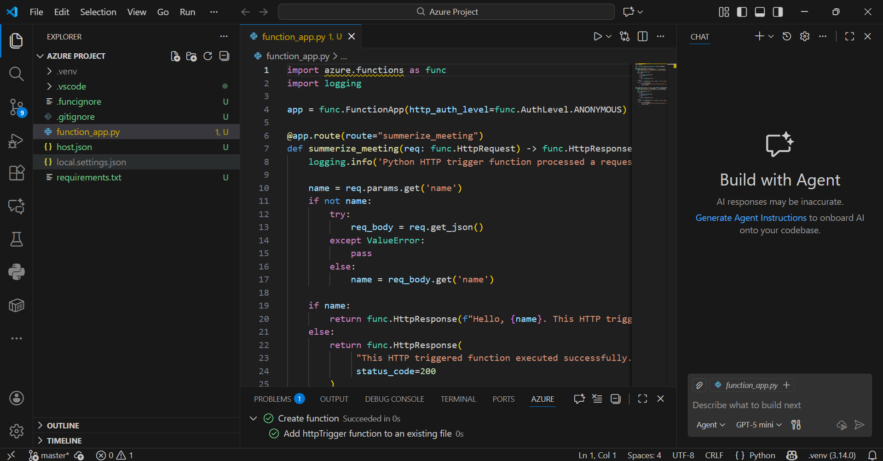

Slide 13
Activity Flow

Slide 14
Activity Flow

Slide 15
Deployment Challenges and Solutions

Slide 16

Challenges
Local Testing
  Initial attempts to run the Azure Function locally failed. The virtual environment was missing critical dependencies for connecting to the Azure services and simulating the Azure runtime.
  Postman also had errors communicating to the Azure resources due to how the resources were being accessed.
  Overcoming it:
  Deleting and reinitializing the virtual environment allowed for a clean slate to work on and allowed me to properly install the required dependencies.

Slide 17
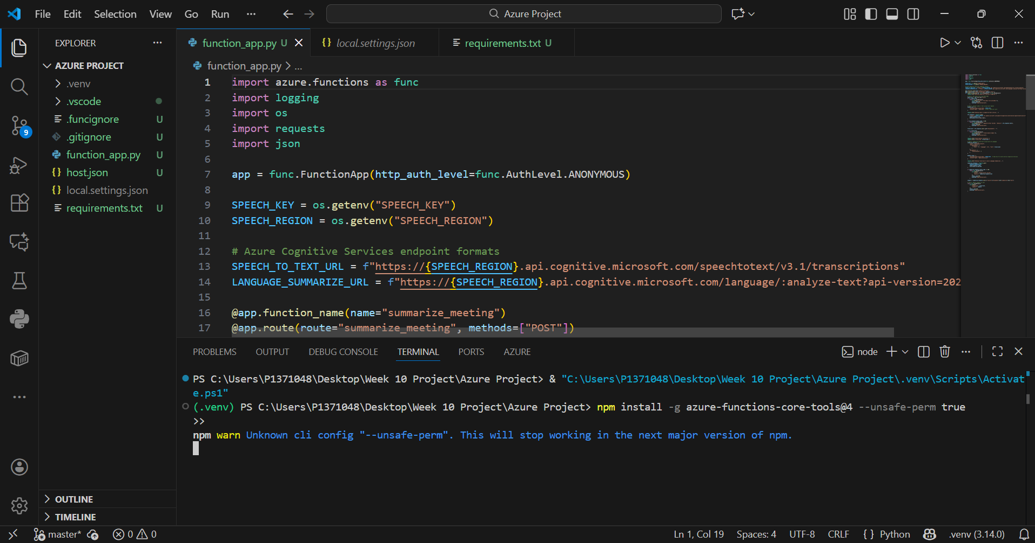

Slide 18
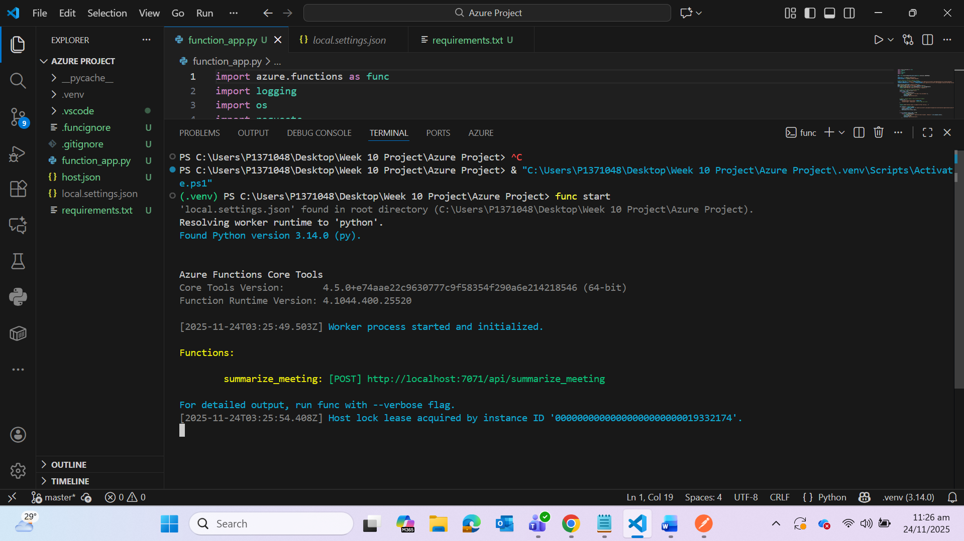

Slide 19
Challenges
API Payload for Language Service
  Communication after to the Language Service, particularly the summarizer feature, had failed multiple times.
  Azure Language Service expects a JSON or transcript document type format to process and present an output.
  The Speech to Text output was ultimately just a string of words with no construct or format.
  Overcoming it:
  After the STT had processed and generated its output, creating and initializing a strict format that the API can recognize was what I did to resolve the error of the failed communication.

Slide 20
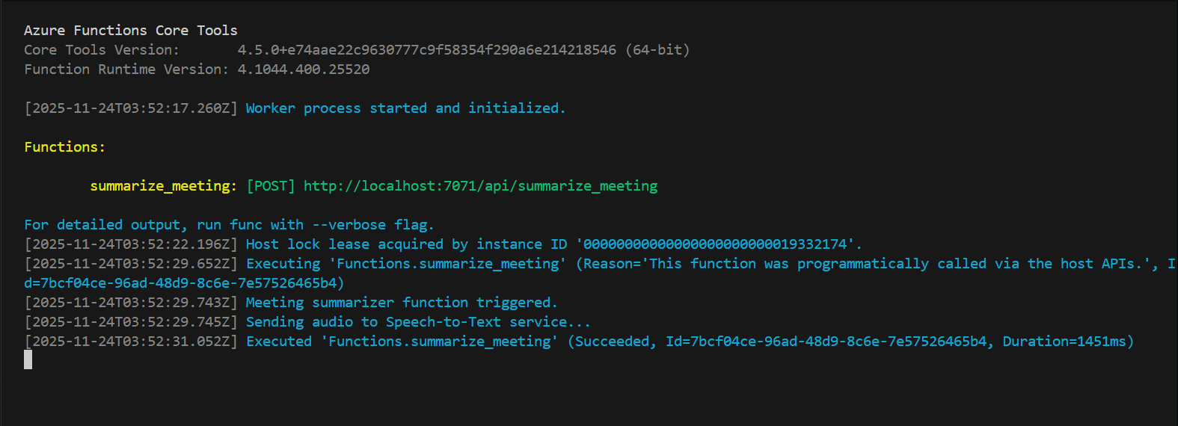

Slide 21
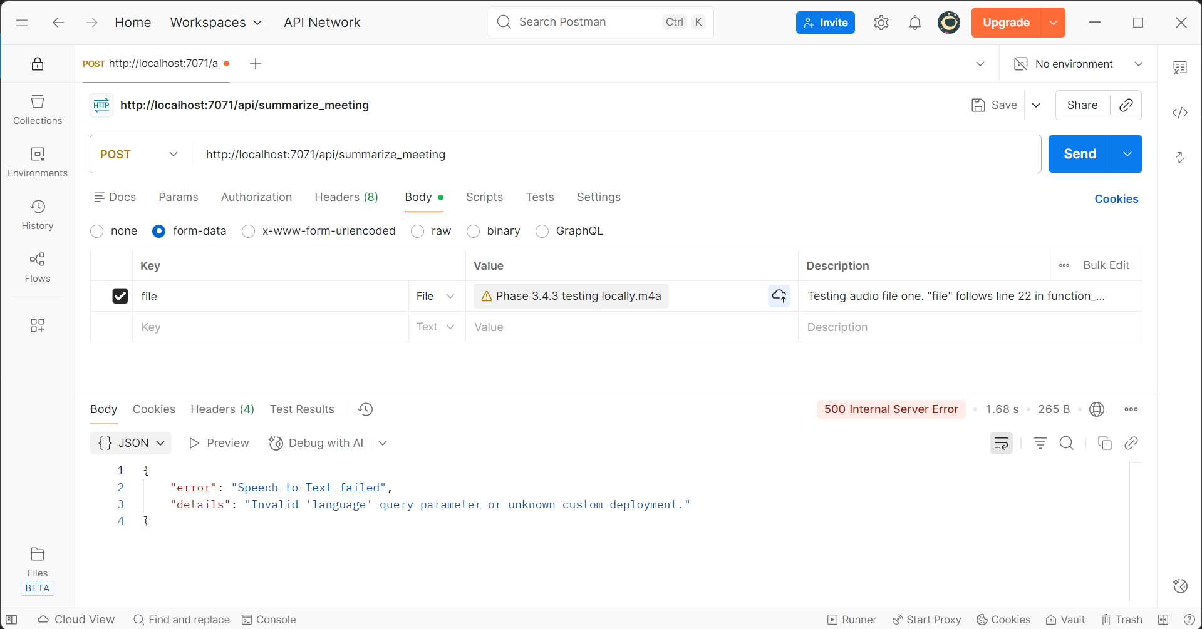

Slide 22
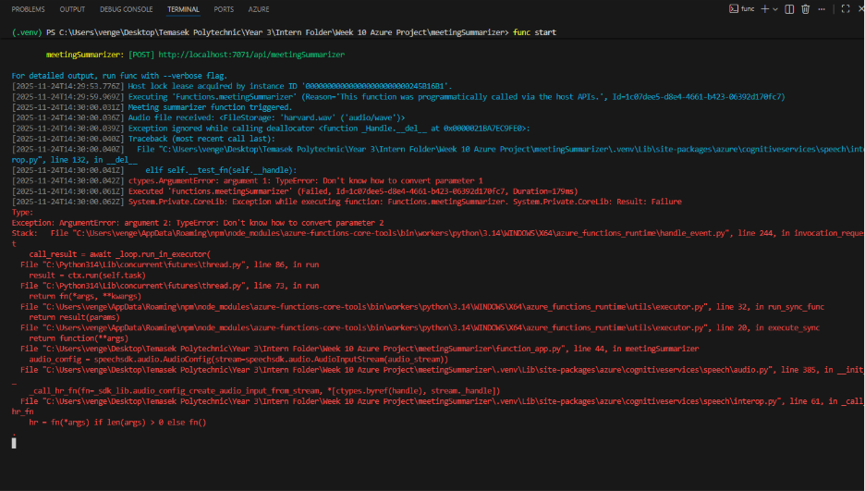

Slide 23
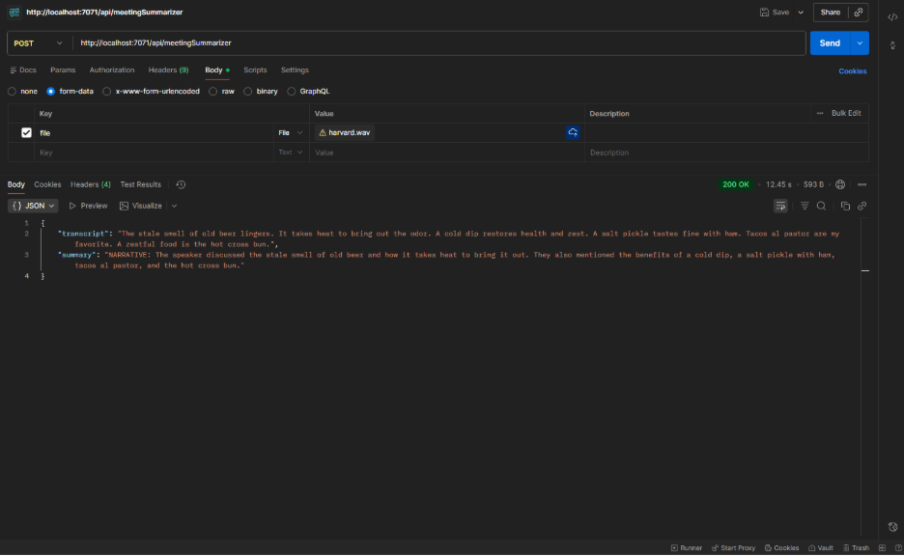

Slide 24
Challenges
Library Conflicts
  Configuration of the virtual environment were corrupted. Phantom libraries were being located and used, which affected how the code communicates with the Azure services.

Slide 25
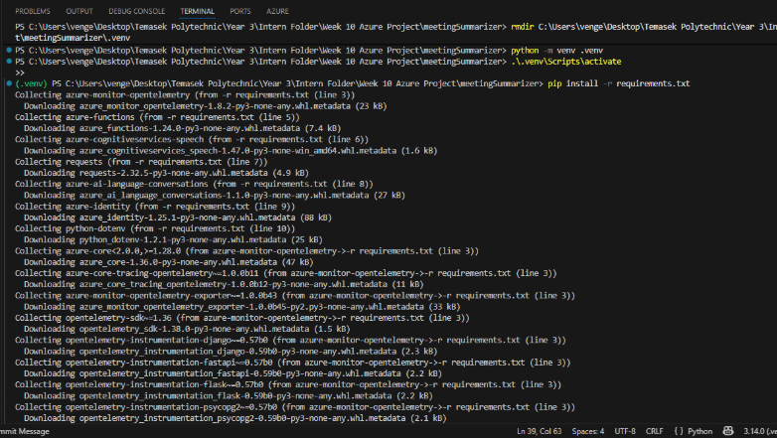

Slide 26
Learning & Takeaways

Slide 27
Learning & Takeaways
Area | What I Learned | Impact
Local Development Environment | Setting up Azure Functions Core Tools locally is critical. Python version parity between local (venv) and cloud runtime avoids silent failures. | Enabled rapid debugging and fixed the initial function startup failures.
API Payload Strictness | The Language Service REST API requires precise nested JSON structures (Conversation Items) rather than simple text strings. | Resolved "400 Bad Request" and "404 Resource Not Found" errors.

Slide 28
Learning & Takeaways
Environment Parity is Critical
Ensuring the local development environment (Core Tools, Python version) strictly matches the cloud runtime prevents "silent" deployment failures.
API Payload Precision
AI Services often require strict, nested JSON structures (like Conversation Items). Adhering to REST API specs over SDK assumptions resolves 400/404 errors.
Serverless Component Orchestration
Understanding how Azure Functions, Blob Storage, and Cognitive Services interact is vital for creating a cohesive, event-driven architecture.
Stream vs. File Handling
Cloud functions process files as memory streams. Implementing temporary file handling is essential when integrating with SDKs that expect physical file paths.

Slide 29
Summary and Recommendations

Slide 30
Summary
Simplified Application Deployment​
Azure Functions and Cognitive Services abstract away the complex infrastructure, allowing us to focus purely on the logic of transcribing and summarizing meetings.
Automatic Scaling and Monitoring​
The serverless architecture inherently supports automatic scaling (Consumption Plan), ensuring the app handles varying workloads without manual intervention or idle costs.
Best Practices for Optimization​
Success relied on secure configuration (Env Variables), precise API payload formatting (JSON), and efficient stream handling using temporary files.
Recommended Solution​
This project proves that Azure's "AI-as-a-Service" model is an ideal solution for organizations seeking to automate manual documentation tasks with speed, accuracy, and minimal overhead.

